Slide 1

LEARN TOK
REIMAGINING EDUCATION FOR THE ALGORITHM GENERATION.
BITE-SIZED LEARNING

Slide 2



THE PROBLEM
EDUCATION IS BORING. ATTENTION IS SCARCE.
The Goldfish Effect: Gen Z has an average attention span of just 8 seconds.
Traditional platforms like Udemy or Coursera suffer from completion rates below 10% because content is too long, unstructured, and lacks engagement.
Learners want the dopamine of social media, but the value of education

Slide 3
VERTICAL FEED
THE SOLUTION: EDUTAINMENT
1
An addictive, Al-driven infinite scroll of educational content. Consumable in 60-second chunks.
STRUCTURED LEARNING
2
Chaos becomes order. Individual reels are tagged and grouped into structured "Micro-Courses"
GAMIFICATION
3
Earn XP, maintain streaks, and unlock badges. Making learning as engaging as a video game.

Slide 4

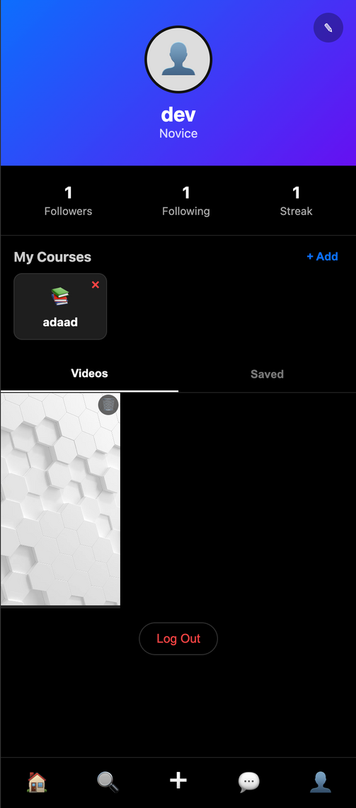
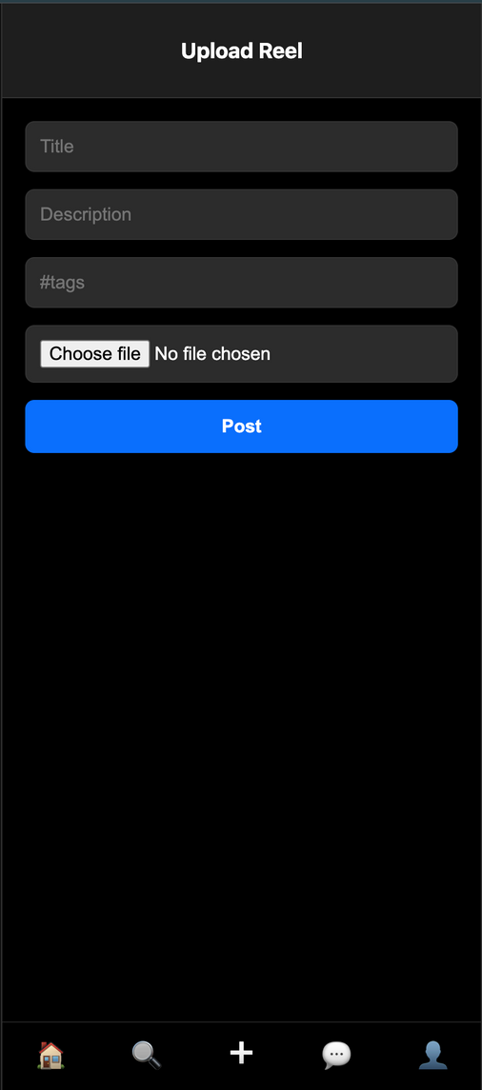
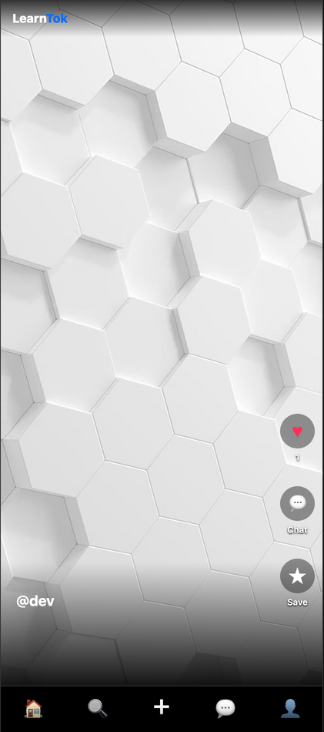
PRODUCT INTERFACE
SEAMLESS USER EXPERIENCE
Smart Feed: Auto-playing videos based on interest graph.
Creator Tools: Upload, tag, and monetize content instantly.
Profile Hub: Track progress, manage uploads, and view saved courses.

Slide 5


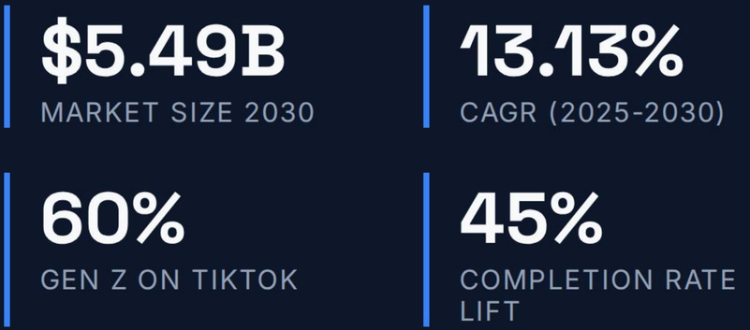
MARKET OPPORTUNITY
The shift towards microlearning is accelerating. We are positioning LearnTok to capture the "Scroll Generation".

Slide 6
2025
STRATEGIC ROADMAP
1
MVP Launch Core feed, Uploads, and Profile logic (Completed).
2026
2
Al Tutors Personalized quizzes generated from video transcripts.
Creator Fund Monetization tools to attract top educators
3
2027
Global Scale Mobile App Launch (iOS/Android) and Localization.

Slide 7

THANK YOU

